Slide 1



Animal Shelter Update
City Council meeting
March 16, 2026

Slide 2
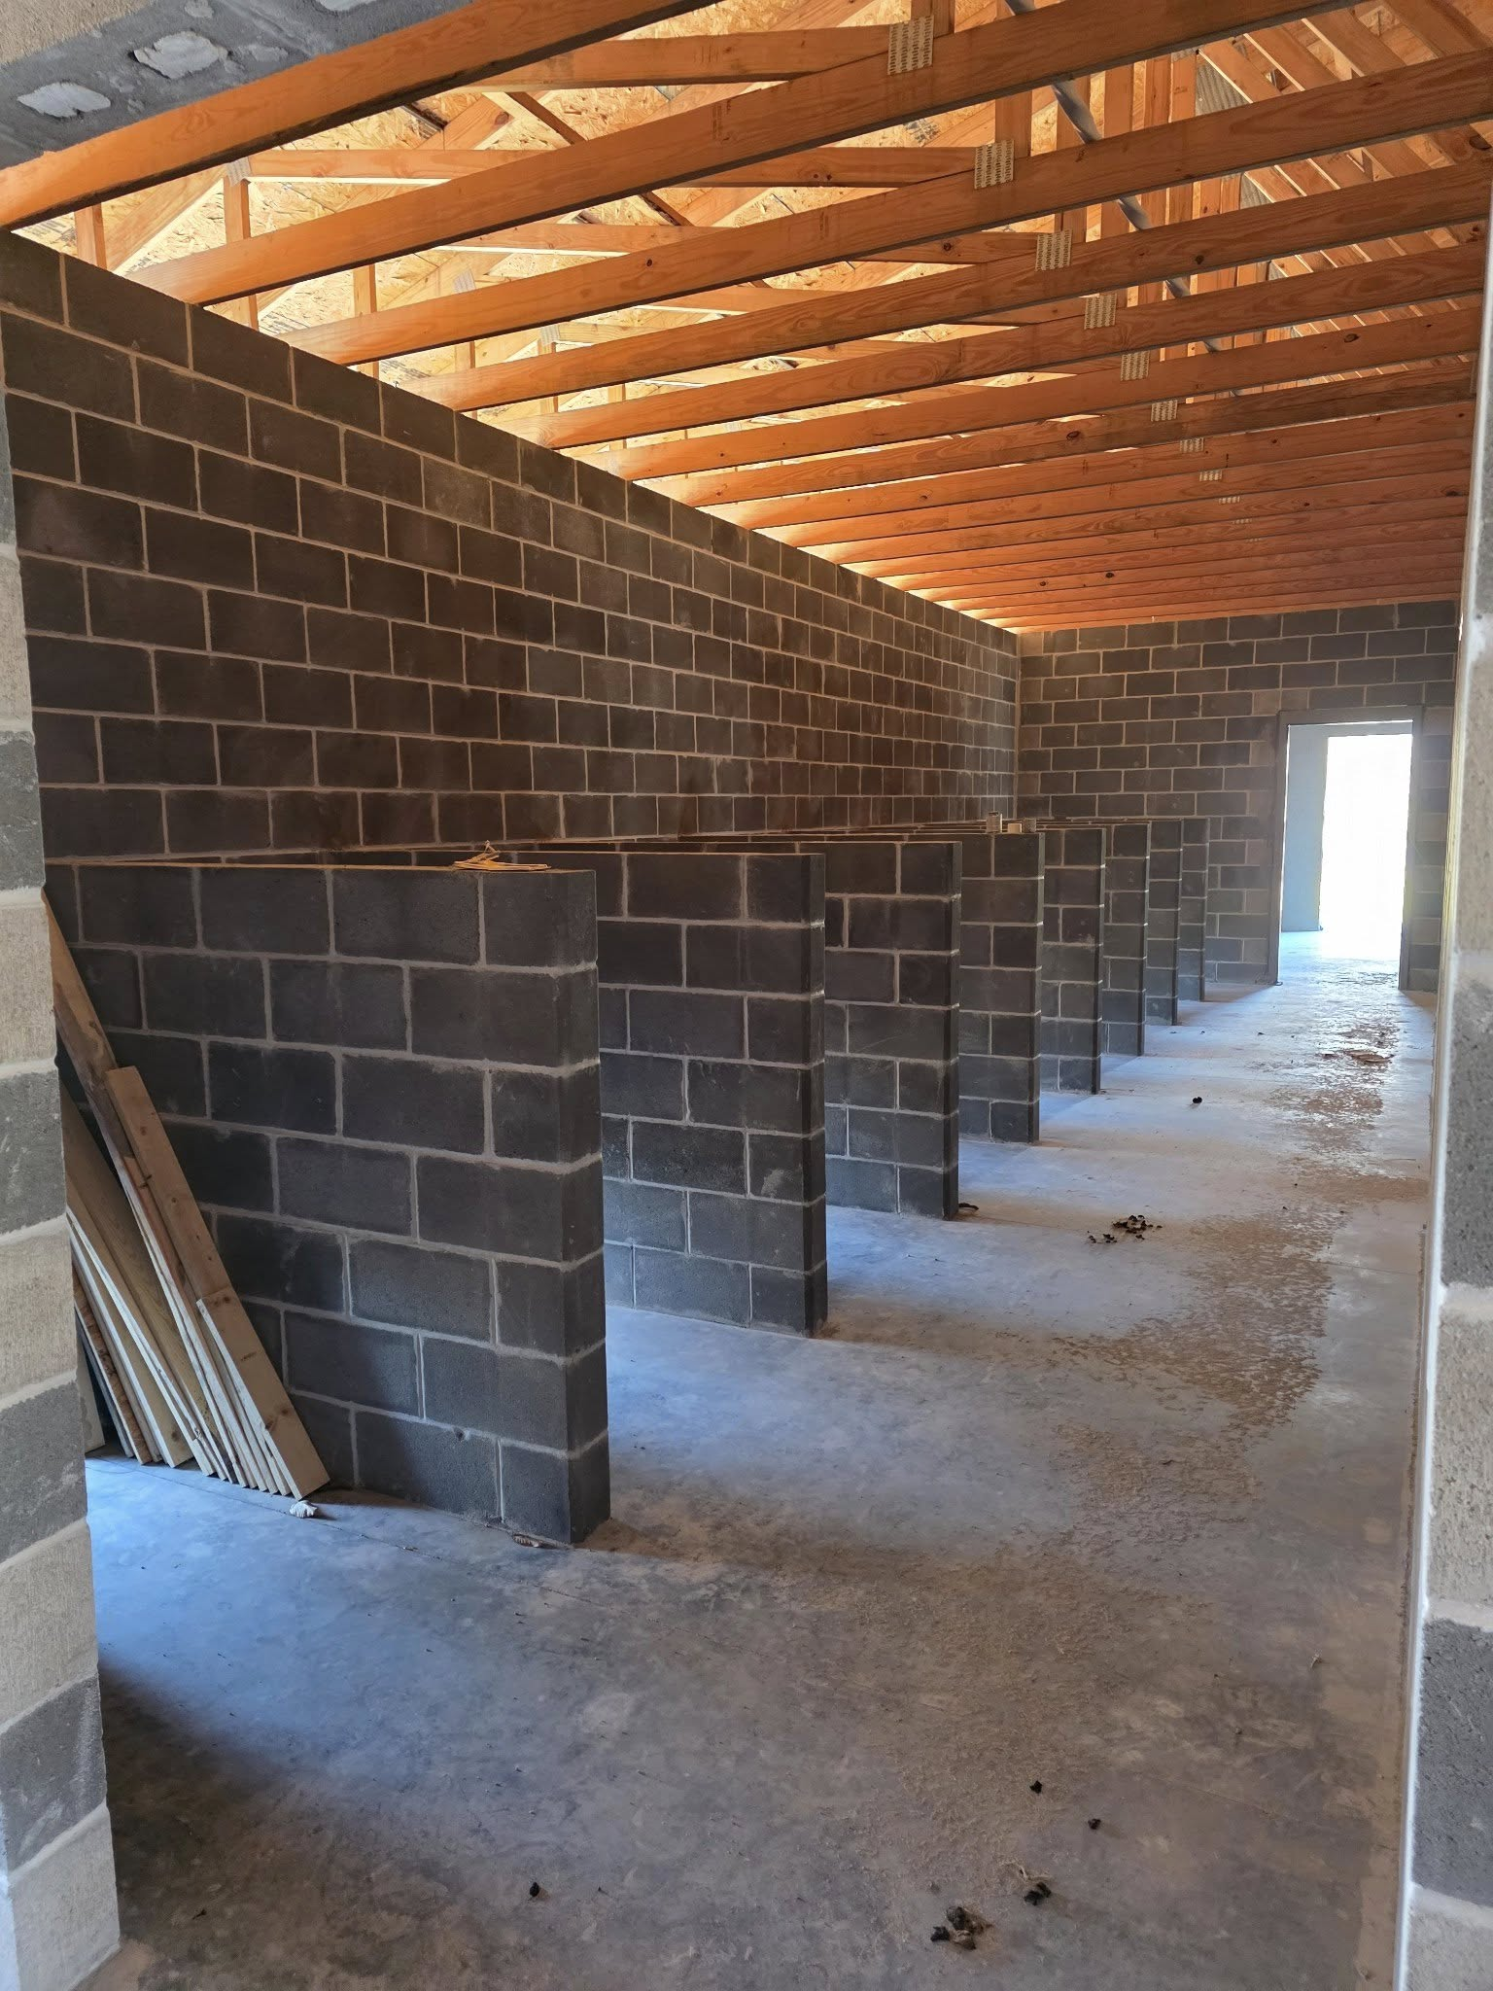
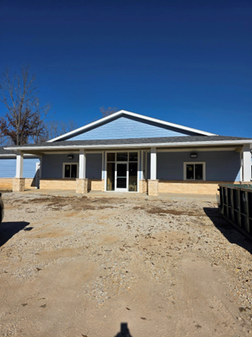

New Animal Shelter – an overview
Feasibility study 2014
Kicked off capital campaign
Broke ground May 3, 2022
Progress continues to be made
Community support vital to success
Goal – completion by end of 2026
Balance of funding needed
  $100,000

Slide 3







Partners who have been instrumental Thank you!

Slide 4


Past Fundraising Activities & Events
Capital Campaign Presentations
Shelter Bricks – active until 03-04-2026 with approximately 78 bricks ordered and $ 13,700 raised
Shelter Open Houses
Professional Group Receptions
Ranney Run – Raised funds annually at community race
Pints for Pups
Informational Displays at Community Events
“Got Sneakers” program
Sold Hoodies and T-shirts
“Dog & Cat Days of Summer” – Fugitive Beach
Methodist Church Camp fund-raiser
Donation Boxes
Trivia Night
Safari – Cub Creek Camp
Loving Paws Dinner Auction

Slide 5

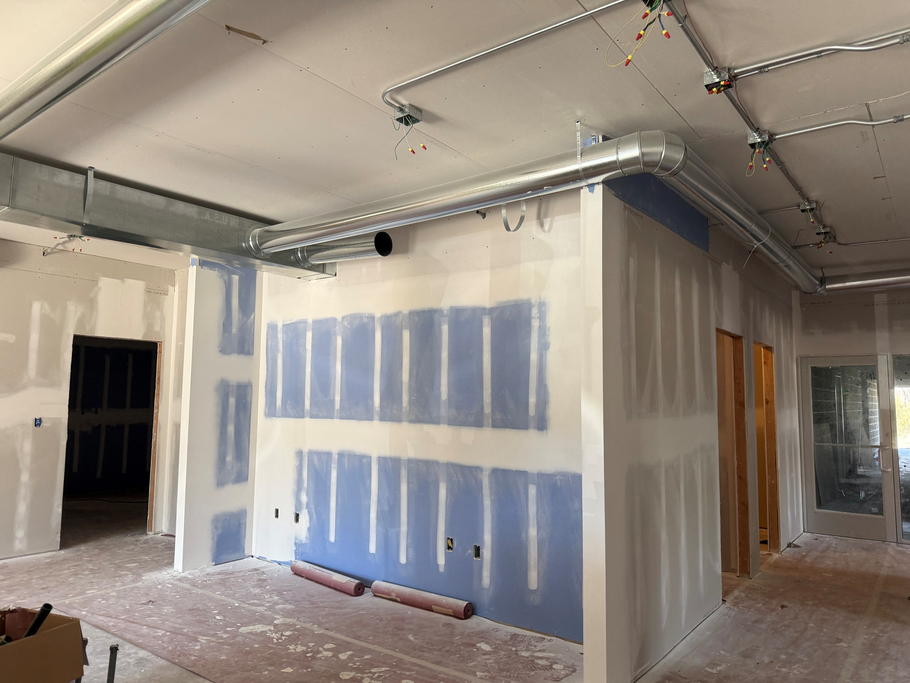
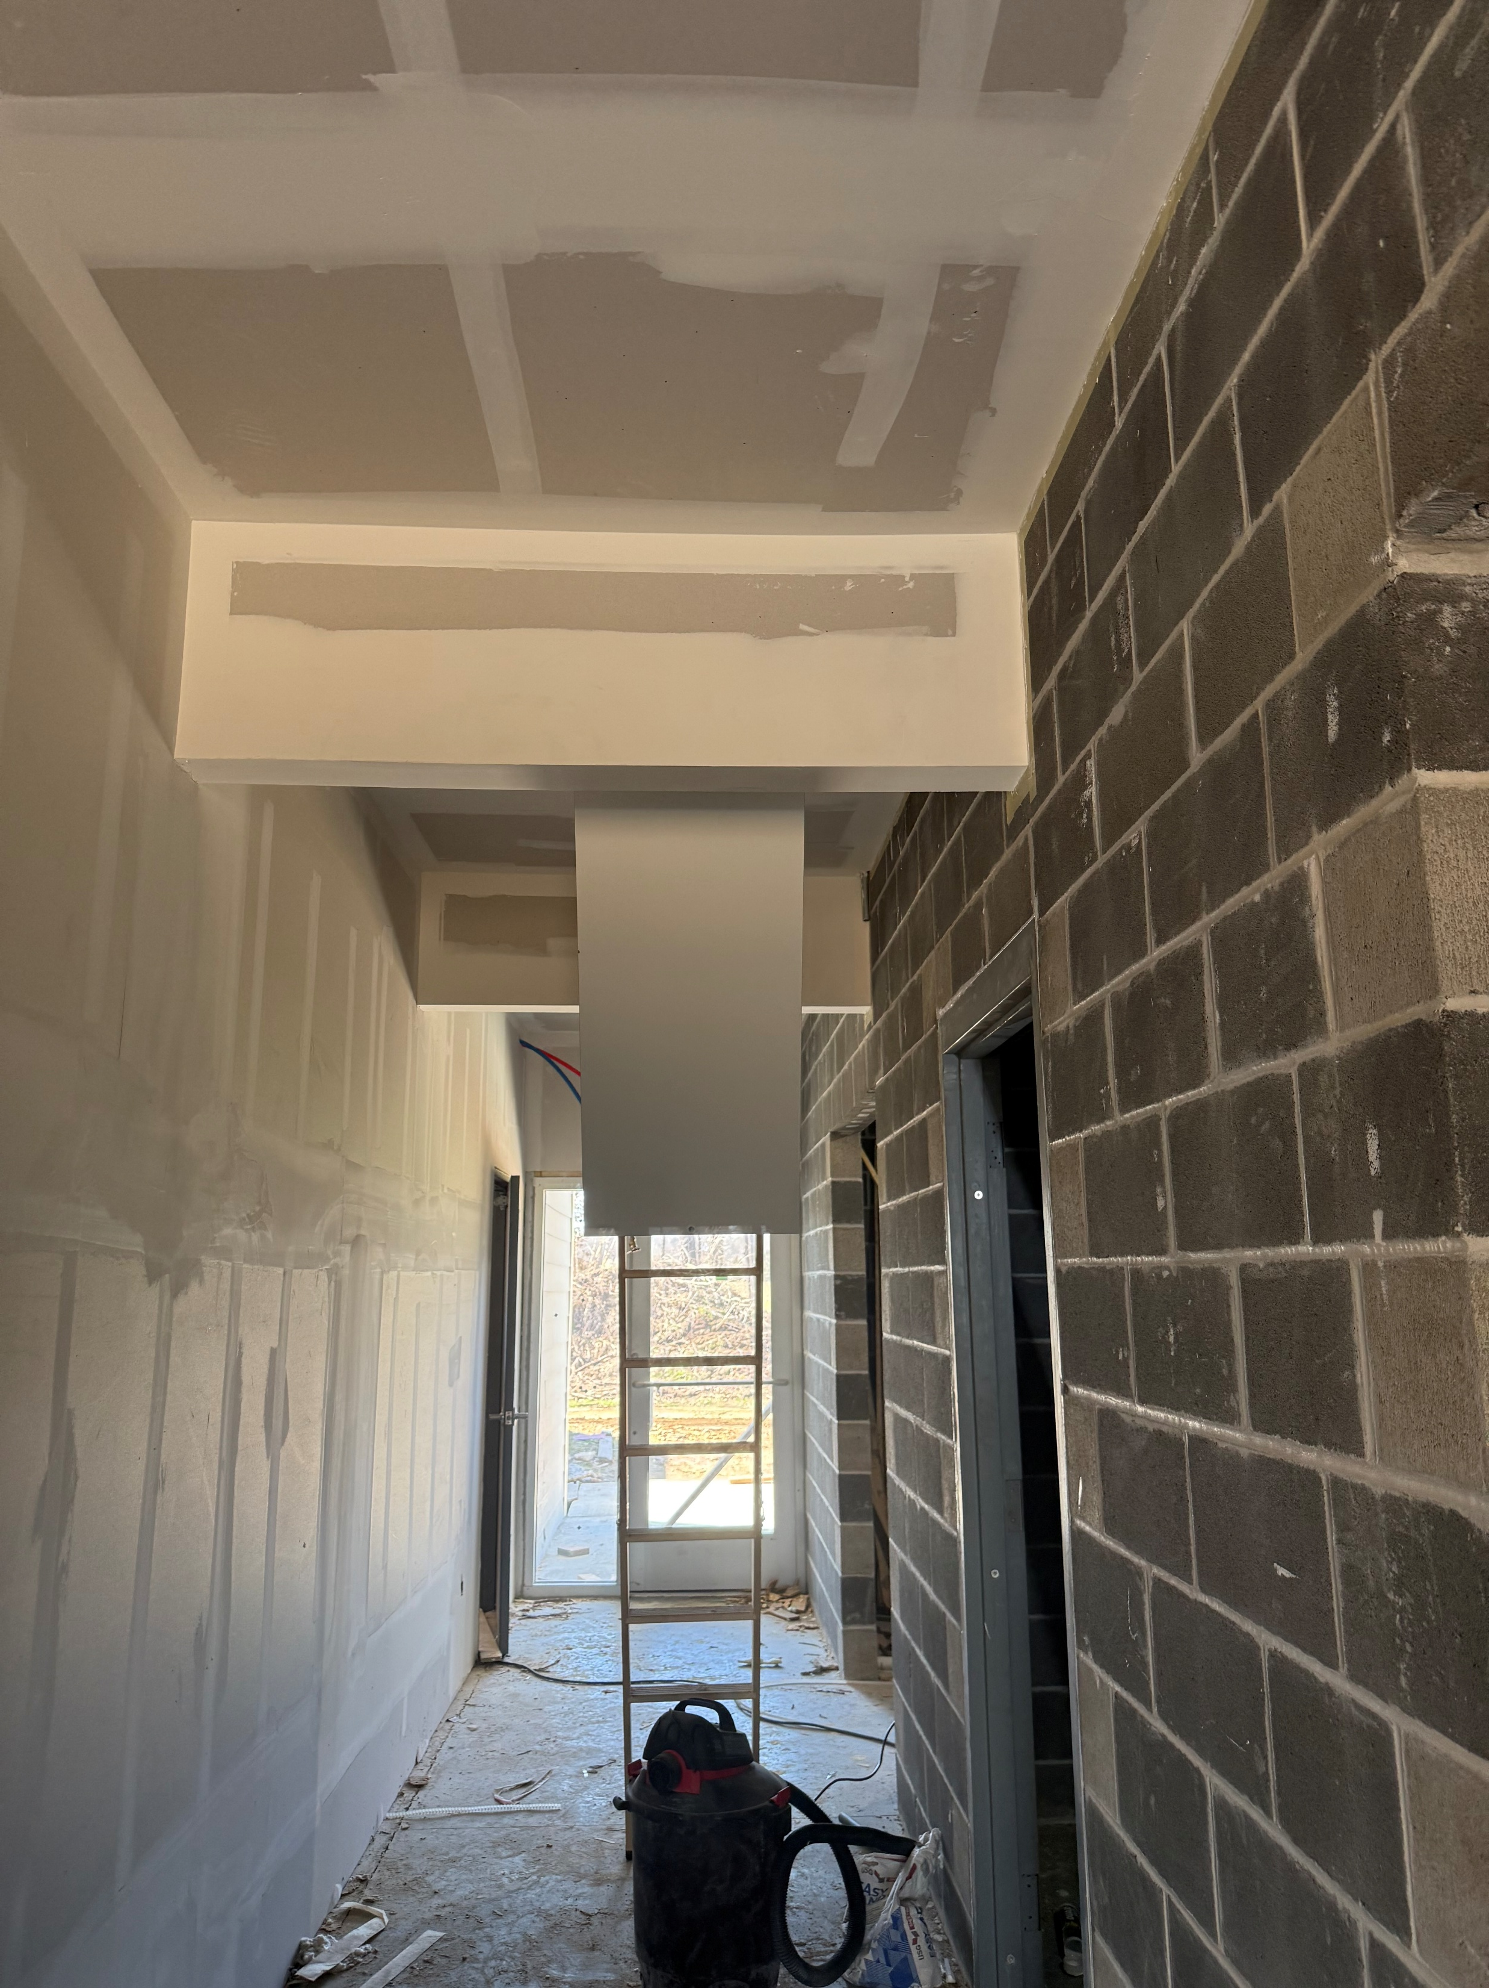
Overview of fundraising to date
Anchor donation - Robert Eck memorial donation
Ranney Memorial
Thomas & Lana Van Doren
Loving Paws
Thomas & Kim Day
Margaret Cunningham
Phelps County Humane Society
Central Federal
Brewer Science
Katherine Bacon Trust
Many others – too many to list
Donations & Interest received to date - $1,159,479!!!

Slide 6
Video
Winter 2026 New Animal Shelter Tour
Special Thanks to Lauren Ranney for sharing this video with us. Her technical skills are always appreciated.

Slide 7


On-going fundraising efforts
One time or reoccurring donations for the New Animal Shelter can be made via Community Foundation of the Ozarks; link accessible through our website.
City of Rolla, Missouri
City commitment to ongoing operations
Continued partnership with NFPs and the community – funding for special expenses and spay/neuter programs
Potential of an advisory board being formed to provide community involvement in shelter as operations transition

Slide 8
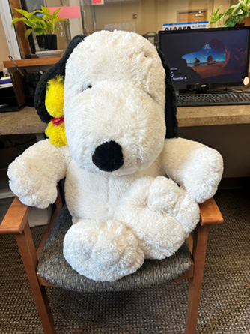
Questions and discussion
Thank you!
Every tail deserves a happy ending!

